Slide 1
At Southern you are given a great environment to stay fit. From Hulsey Wellness Center to your dorm’s basement gym you have many opportunities to stay fit. Anybody who plays intramurals knows it’s nice to win. How do we win… by becoming more athletic in our sport. This simulation you are about to embark on you will choose a sport and be given a goal and you must create a fitness plan that will allow the character you create to be able to meet the goal in three months. Press next to begin
Next

Slide 2
Load Character
New Character
Credits

Slide 3
Choose Your Gender
Male
Female

Slide 4
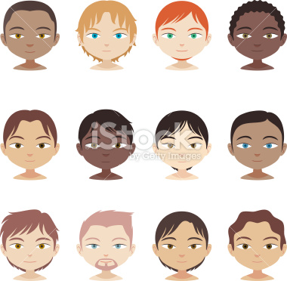
Pick Your Character

Slide 5

Pick Your Character

Slide 6
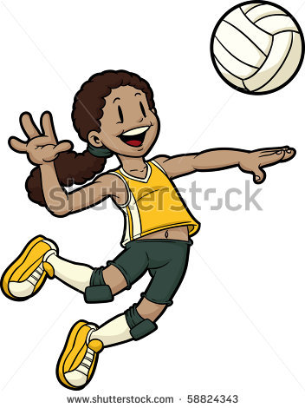
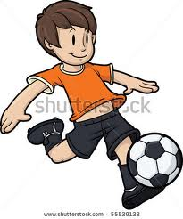
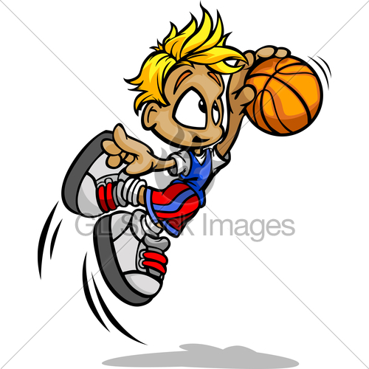
Choose A Sport

Slide 7
Basketball
Goal: Be able to Dunk
Muscle Groups to be worked out:
Chest, Shoulder, Triceps, Abs, and Biceps, Glutes, Quads, and Hamstrings, and traps.
You will have to create a fitness plan for three months
1st Month you will focusing on raw strength
2nd Month you will be focusing on explosion
3rd Month you will be focusing on endurance
You will be working out three days a week
Rotate each week 1 lower body 2 upper body 2 lower body 1 upper body
Press next to begin
Next
Notes:
There should be a picture

Slide 8
Personal Assessment
Exercise | Max Weight | Reps
Bench Press |  | 5
Military Press |  | 5
Squats |  | 5
Deadlifts |  | 5
Romanian Deadlifts |  | 5
Go to the gym and find a weight where you can only do five. The fifth will be a struggle and enter it here.

Slide 9
Calendar
Sunday | Monday | Tuesday | Wednesday | Thursday | Friday | Saturday
Sunday | Monday | Tuesday | Wednesday | Thursday | Friday | Saturday
Sunday | Monday | Tuesday | Wednesday | Thursday | Friday | Saturday
Sunday | Monday | Tuesday | Wednesday | Thursday | Friday | Saturday
Simulate

Slide 10
Sunday
Exercise | Weight | Reps | Sets
Bench Press
Military Press
Squats
Deadlifts
Romanian Deadlifts
Submit

Slide 11

Progress
Red means risk of injury and little to none improvement
Green means max improvement
Blue means improvement

Slide 12
Month 1
Focus: Building Strength
You will be doing the following exercises:
Bench Press
Military Press
Pull Ups/Pull Downs
Squats
Deadlifts
Romanian Deadlifts
Play the Sport

Slide 13
Monday

Slide 14
Wednesday

Slide 15
Thursday

Slide 16
Friday

Slide 17
Saturday

Slide 18
Sunday

Slide 19
Soccer
Goal: Be able to run quicker, longer and kick harder.
Muscle Groups to be worked out:
Chest, Shoulder, Triceps, Abs, and Biceps, Glutes, Quads, and Hamstrings, and traps.
Duration: Three months

Slide 20
Volleyball
Goal: Be able to jump higher to spike the volleyball.
Muscle Groups to be worked out:
Chest, Shoulder, Triceps, Abs, and Biceps, Glutes, Quads, and Hamstrings, and traps.
Duration: Three months

Slide 21
Objective
You will have to design a workout schedule using strength training for the next three months that will guarantee results for your goal.

Slide 22
Definition
  The Cooper Institute defines Strength as, “The ability of a muscle or group of muscles to generate force at a specified velocity.”
  Strength can also be defined as: Force = Mass x Acceleration (velocity)
  Hypertrophy: Increase in the size of muscle fibers.
  Atrophy: Decrease in the size of muscle fibers.
  Isometric Exercise: Strength exercise with little or no movement. (i.e. The Plank)
  Isotonic (dynamic) Exercise: Exercise through the full range of motion.
  Eccentric: Lengthening of the muscle.
  Concentric: Shortening of the muscle.
  Set: A group of repetitions.
  Repetition: Performing the specific exercise one time.

Slide 23
Benefits
  Optimal performance in daily activities (walking, running, lifting…).
  Improved posture.
  Increase resting metabolism.
  Lower risk of injury.
  Improves personal appearance, self-image and psychological well-being.
  Increase in lean body mass
  Lower body fat.

Slide 24
Strength Training Recommendations
  A warm-up is recommended due to the fact that strength training is most effective when the muscles are warm.
  A minimum of 2-3 days per week is recommended with at least a 48 hour separation between workouts of the same muscle group.
  Intensity varies with the type of strength training being done. Weight training exercises should be done at 80% of 1RM. Body weight training is done over 3-5 sets that are timed with rest periods in between. Plyometric exercises are done with sets/reps or timed.

Slide 25
Overload Principle
  Simply stated the Overload Principle is increased resistance (intensity) over time. This can be done in several ways:
    Increase resistance
    Increase repetitions
    Decrease rest period between sets
    Increase the total volume of the workout

Slide 26
Types of Strength Training
  Weight Training: Exercises performed with the use of weights and bars as resistance.
    Free Weights: This type of training requires the individual to balance the weight while performing the exercise. Several benefits of using free weights include; variety of exercises, cost and portability.
    Machines: The use of machines in strength training has several advantages: muscle specificity, safety, resistance variability, and time.
  Body Weight Exercises: Strength training that can be done simply with the use of the individual’s personal body weight. This type of strength training can be done anywhere with little or no equipment, costs virtually nothing and includes a large variety of exercises for several muscle groups.
  Plyometrics: Explosive, dynamic movements. This is a form of training for power and strength. (i.e. Box jumps)

